Slide 1
Resource Manager
Name:
Developer Experience, Oracle Cloud Infrastructure
Copyright © 2021 Oracle and/or its affiliates.
Notes:
Hello everyone, my name is Uma Balasubramanian. I am software engineer in Oracle Cloud Infrastructure. I am here to talk about Oracle Cloud Infrastructure Resource Manager

Slide 2
Agenda
Infrastructure-as-Code (IaC): Enablement and Benefits
Why Resource Manager?
How does it Work?
New Features
Resources

Slide 3
Infrastructure-as-Code (IaC): Enablement and Benefits
Infrastructure as code - Approach to define the infrastructure (computing, network, LB etc.) through source code that can then be treated just like any software system
IaC Enables
Customer Benefit
Outcome
Reduced Mistake / Risk
Improved Collaboration
Customer managing their infra easily and reliably
Repeatability
Idempotency
Reduced Complexity
Increase accountability and compliance
Agility
Auditability
Increased Productivity
Notes:
3

Slide 4
Resource Manager Overview
What is It?
Managed terraform-as-a-service
Use Infrastructure-as-Code (IaC) to automate provisioning across all OCI infrastructure resources
Complete CLI, SDK and Console Support
What Problems Does it Solve?
Infrastructure state management
Parallel execution can lead to undesirable infrastructure outcomes
Limited access controls around execution of Terraform commands
Key Benefits
Automate and standardize your infrastructure & easily replicate environments
Deep integration with OCI Platform (i.e. Identity, Tagging, etc.)
Seamlessly manage state files and improve team collaboration
Oracle Differentiation
No lock-in, simple migrations from/to private and 3rd party clouds
Built on unmodified open-source software Terraform for IaC on Oracle Cloud and on-premises
100% day-1 support for new OCI services and features
Notes:
Resource Manager is a fully managed service that lets you provision and manage infrastructure resources using Terraform.
You can bring in your Terraform template definitions and easily create and manage your infrastructure resources.
This allows you to use infrastructure-as-code to automate provisioning across all OCI resources including Compute, Networking, Storage and much more.
It currently has support for CLI, SDK and Console.
Resource Manager helps mitigate a lot of problems that users face while deploying resources on any cloud. You could write your Terraform configuration once using the HashiCorp Configuration Language and use it to create multiple environments.
Resource Manager saves the state securely for you on our object storage and also locks it if multiple members from your team are trying to modify it, preventing any possible corruption and inconsistencies.
You can also define permissions for your team through policies and give granular access controls for various Terraform actions like plan, apply, and destroy.
Resource Manager is built on open source standards and integrates well with the overall OCI Platform including IAM, Tagging and KMS and much more.

Slide 5
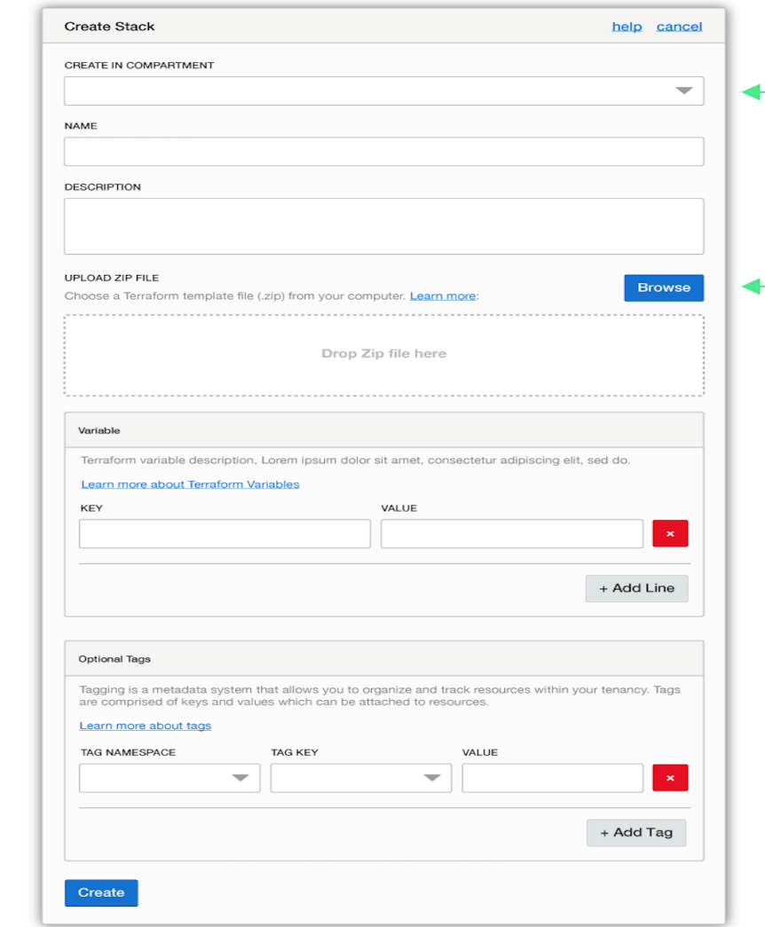
Resource Manager Key Terminology
A stack represents a set of OCI resources you create in your tenancy.
Each stack maps to a Terraform configuration and state file
A job performs the actions that are defined in your configuration.
Possible actions are Plan, Apply, Destroy, and Import State
Copyright © 2021 Oracle and/or its affiliates.

Slide 6




How does it work?
Author/Update
Terraform config files
Sample templates
Private templates
Import existing infrastructure
Source Code Control Repo
Console Wizard
Create/Update
Resource Manager Stack
via
Console
SDK
CLI
Run Job
Plan/
Apply/
Destroy/
Import State
To provision and manage
the infrastructure resources
View managed state and
resources provisioned
Detect Drift
Notes:
So How does Resource Manager orchestrate infrastructure provisioning?
There are multiple ways to get started in Resource Manager -
You start with authoring terraform config files that describes your infrastructure OR You can start with the sample templates that were described in the previous slides OR You can import existing infrastructure in a single click – I will talk about this shortly.

Slide 7
Selected Features

Slide 8
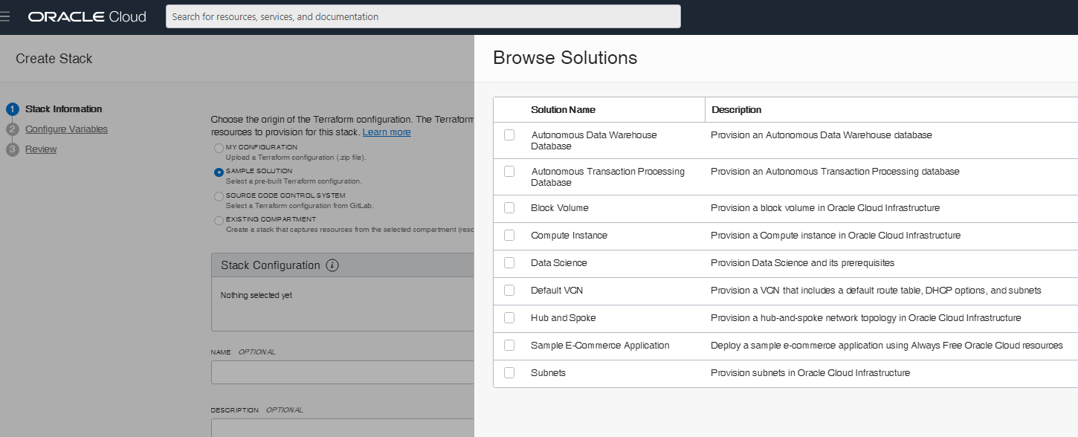
Solution Hub
Field Enablement
New User
Advanced User
Demo sample architecture/OCI services to potential customers
Learn basics of writing Terraform code for OCI
Learn the best practices of creating solutions for production workload

Slide 9
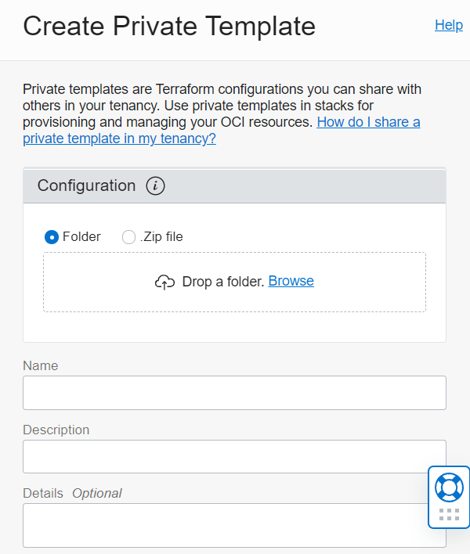
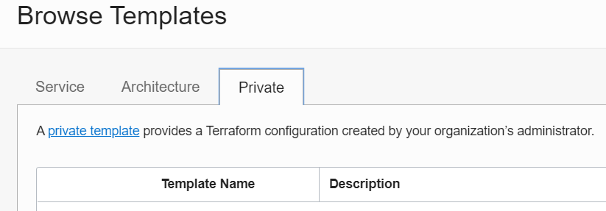
Private Template
Share Terraform configurations with others in your tenancy

Slide 10
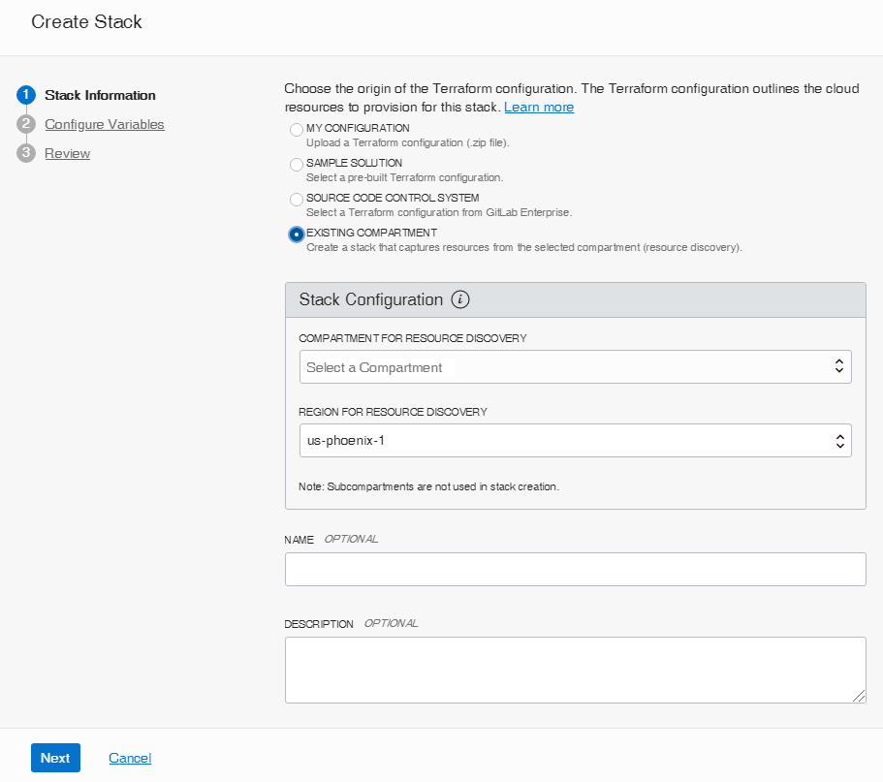
Resource Discovery to Import Existing Resources
Move from manually-managed infrastructure to infrastructure orchestrated by Resource Manager
Duplicate or rebuild existing infrastructure
Get started with Terraform

Slide 11
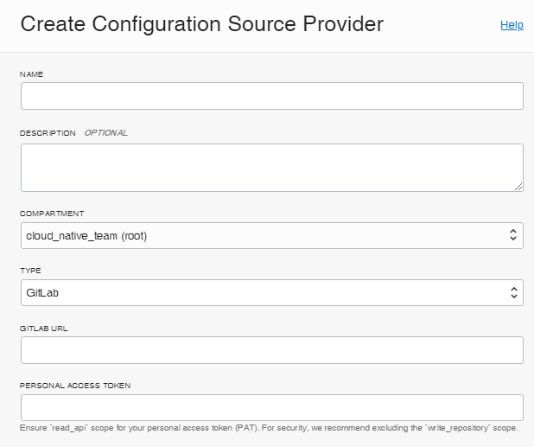
GitLab/GitHub/Object Storage Integration to Store Config Files
Faster code iteration
Leverage CI/CD best practices to infrastructure management
Version, track changes and restore
More source code control systems to come

Slide 12
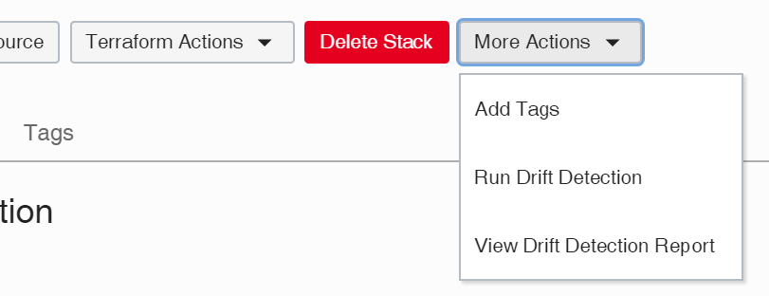
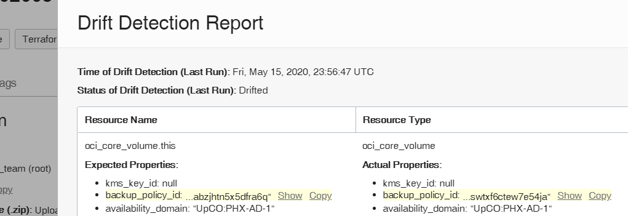
Drift Detection
Drift - Difference between the real-world state of your infrastructure and the stack's last executed configuration

Slide 13
Summary
Resource manager as Infrastructure-as-Code enabler
Customers can scale their workload easily and reliably
Create your first Terraform configuration code using
Solution Hub
Resource Discovery
Iterate Terraform configuration code from GitLab/GitHub/Object Storage
Ensure compliance using Drift Detection
Copyright © 2021 Oracle and/or its affiliates.

Slide 14
Resource Manager – Learn More
Solution Hub
https://console.us-phoenix- 1.oraclecloud.com/resourcemanager/stacks/create?preselectSolutionsList=true
Solution Hub Docs: https://docs.cloud.oracle.com/en-us/iaas/Content/ResourceManager/Reference/solutions.htm
External website: https://cloud.oracle.com/resource-manager
Hands-on-Lab: https://oracle.github.io/learning-library/oci-library/
Overview: https://youtu.be/udJdVCz5HYs
Blog: https://blogs.oracle.com/cloud-infrastructure
/getting-started-with-the-resource-manager-on-oracle-cloud-infrastructure
https://blogs.oracle.com/cloud-infrastructure/two-tools-to-bring-your-existing-infrastructure-under-terraform
https://blogs.oracle.com/cloud-infrastructure/drift-detection-for-infrastructure-resources-using-resource-manage
https://blogs.oracle.com/cloud-infrastructure/create-resource-manager-configuration-and-state-files-by-discovering-existing-compartment-resources
Service Docs: https://docs.cloud.oracle.com/iaas/Content/ResourceManager/ Concepts/resourcemanager.htm

Slide 15
Thank You!

